Slide 1
Instructions for About Me Cell Phone
This is an activity meant to get to know you.
Search for pictures that will fit in the boxes for first cell phone screen. (Crop/adjust images if necessary)
Insert text boxes where needed to answer the questions in the chat box in slide 3 & 4.
In slide 5 insert text boxes to give more information about yourself.
The last slide is blank because I want you to think about pre-covid and post covid. What is something you miss doing or wish you would have done more of? What is something that you now do that you didn’t do before? Use this slide to input images, text, or both.

Slide 2
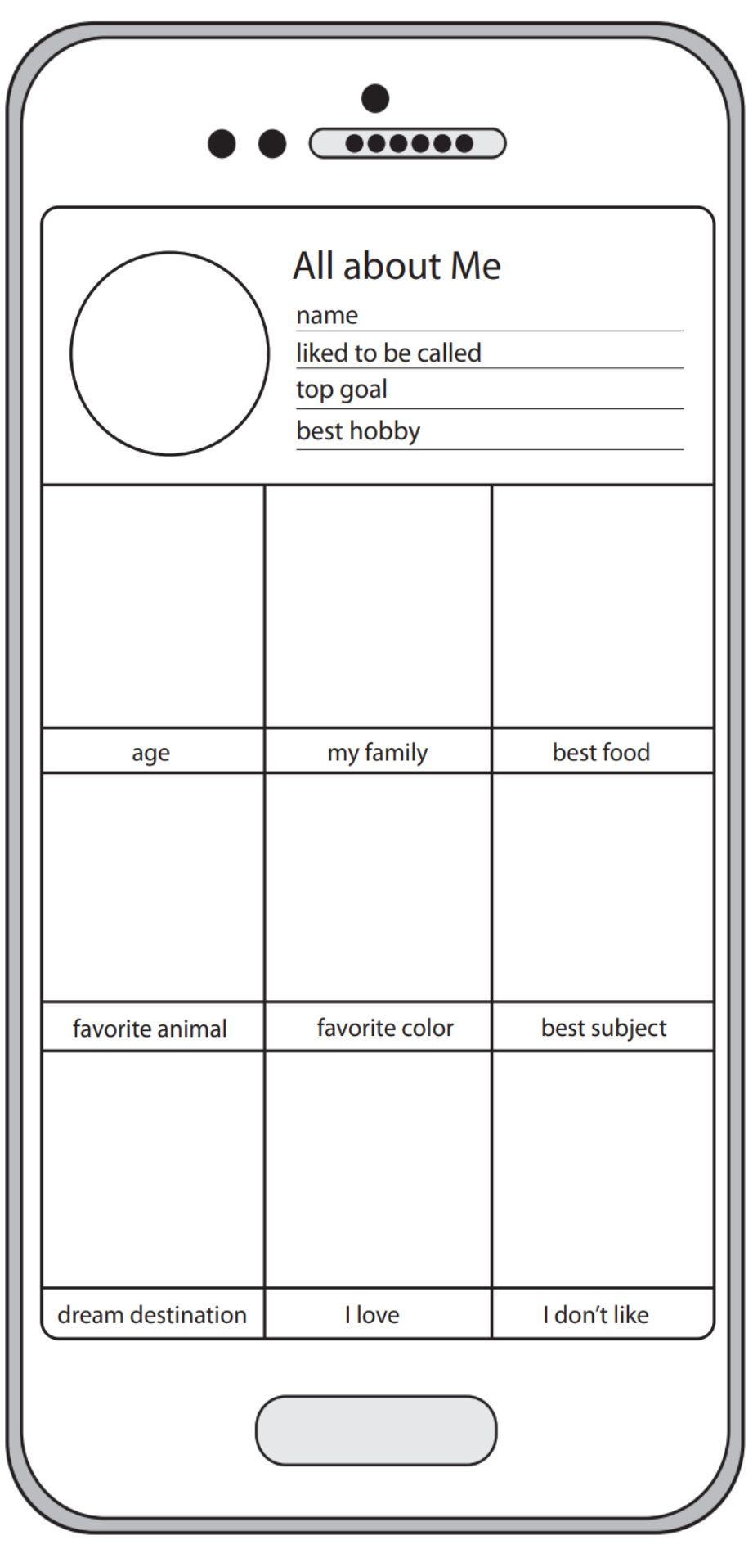

Slide 3
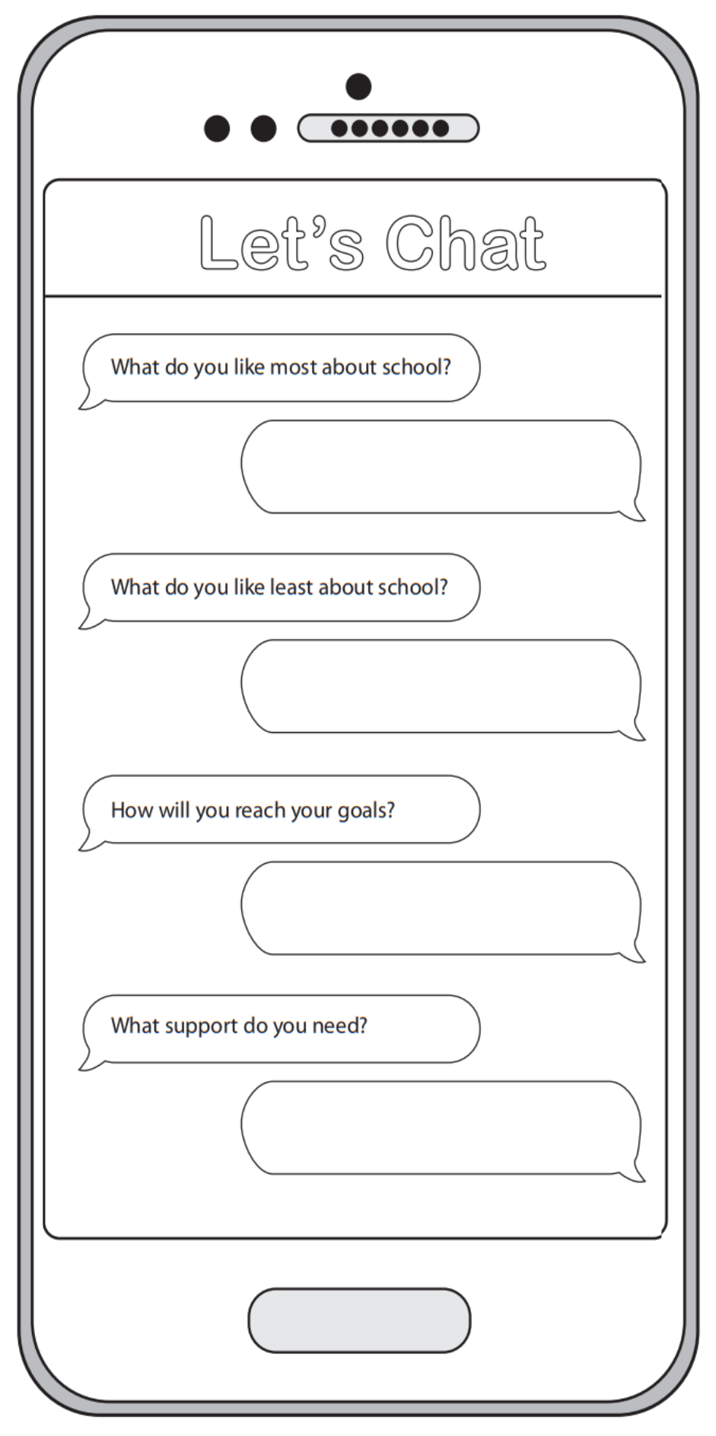

Slide 4
When is your birthday?
Are you involved in any extra-curricular activities? If so, which ones?

Slide 5
